Slide 1
Yelp
Group: NaCl
Kanyarak Anuchitlertchon
Linette Maliakal
Uljana Sejko
Janeen Soria

Slide 2

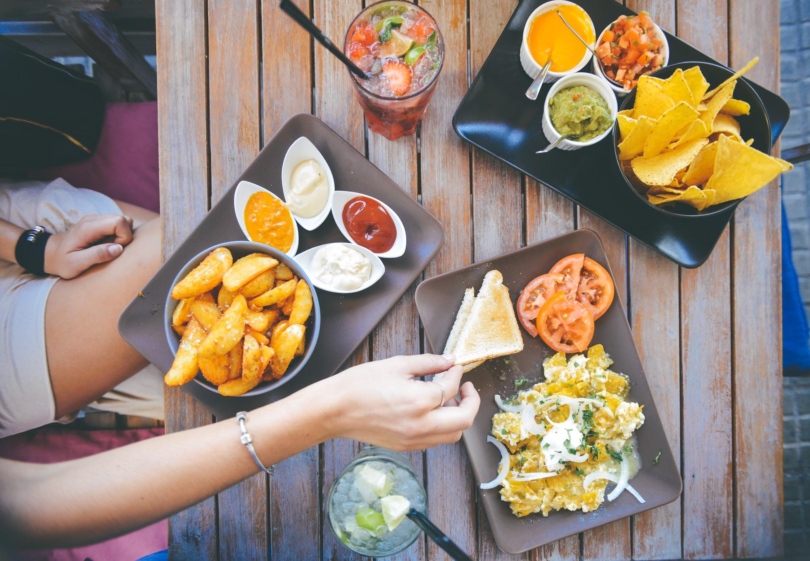

Notes:
Began by thinking of what young adults tend to think about: places to go, food to eat, prices, etc.
Came up w/ Yelp, looked at interface & saw many features that could make navigation & use much easier for those seeking information abt businesses and those wanted to provide information

Slide 3

Vision & Interface
Color scheme only two colors:
Red and white
Usable by any color blind user.
Red
Psychologically stimulates appetite.
Stands out the most compared to other colors.
Notes:
I like Yelp color scheme as it has only two color. One benefit of this is that it guaranteed that the website is usable by any color blind user. Red, their primarily color, is a good color for psychologically stimulating appetite so it fits the site's purpose. Red also tend to stand out the most compared to other color. This is likely the reason why some of the most successful fast food chains, such as McDonald, KFC, or Wendy's, uses red as their primary color.

Slide 4
Vision & Interface
Improve the use of space
reduce the amount of white space
expand laterally: makes reviews seem less cluttered.
use some truncation
Ex: Facebook, long status posts are shown truncated, with a "See More"
Notes:
Yelp should reduce the amount of white space its wasting. If the interface would expand laterally, the reviews would seem a lot less cluttered. The reviews themselves could also use some truncation. For instance, on Facebook, long status post are shown truncated, with a "See More" button that allows the user to view the full post. Yelp could use a feature similar to that.
Another aspect which contributed to the clutter, the advertisement on the site goes a step too far by including reviews of the advertised restaurant.

Slide 5
At a glance...
Homepage Background change with pictures taken by users
Adds authenticity, emphasizes the importance and reliance on users.
Questions and Answers Feature
Chance to ask venue specific questions related to businesses.
Recent Activity section of Homepage
Distracting, disorganized.
Users need few & key focus points on the website.
Map on business profile
Info can be simplified (directions, website link).
Notes:
Initially we thought abt yelp in general. Now will focus on business page

Slide 6
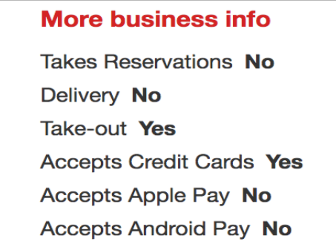
Potential Changes
Hours of business section:
Show current status
Expand/Compress list
More business info section:
Checklist format
Ex: Takes Reservations ✓

Slide 7
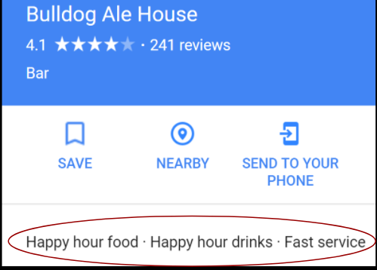
Potential Changes
Descriptive & distinctive key words:
Google Map model
Ex: Popular for: Brunch, Ambiance: Casual
Add at the top so the user can associate the business with those words.

Slide 8
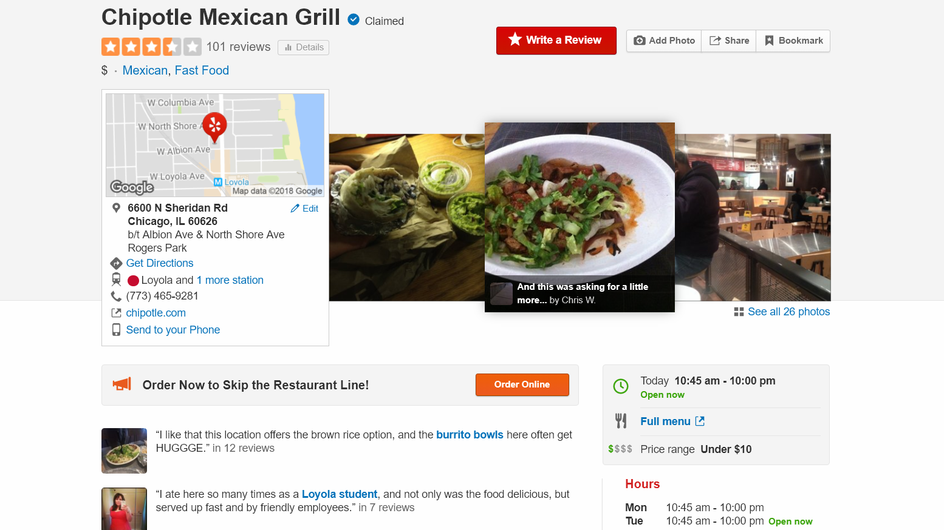
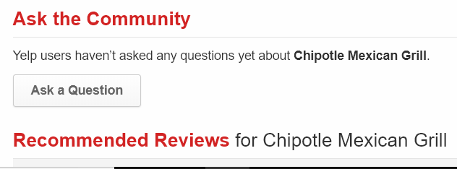
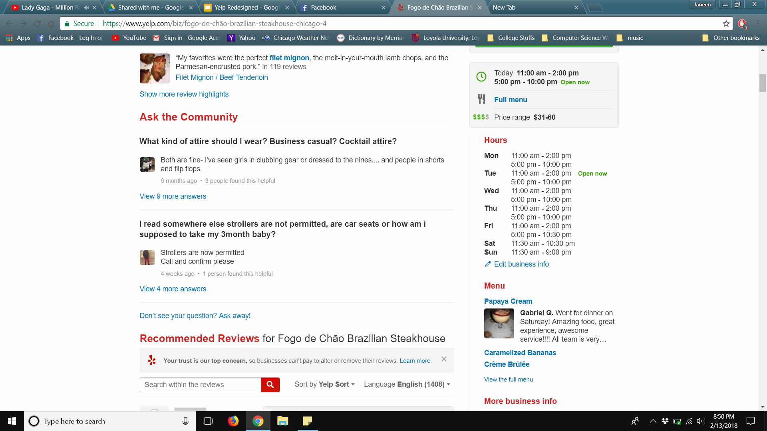
Focus and User Interaction
What should the user click on? Is attention focused on most important feature?
Notes:
What to click on? (red “Write a Review” or orange “Online Order”?)
Some of the more helpful features are not more obviously shown (“Ask a Question” button)
-something to consider: bottom right screenshot is different review where there are questions in the section, less obvious on how users can post their own question (now as a blue link, not button), and if there are more questions, then the link would get lost in all the text they would see

Slide 9
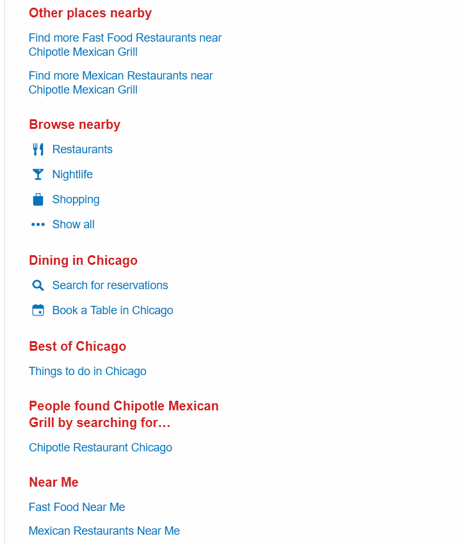
Focus and User Interaction
Features not categorized well/repetitive
Notes:
“Get Directions” and “1 more station” are the same link
Many “Nearby” categories that all do similar tasks
Some of the other categories only have one link underneath. Unnecessary for it to have its own category
(reference previous screenshot) there are at least 3 places where user is directed to the store website: under the map, over the store hours, underneath the highlighted reviews,
just need one link for the store website, should just direct to the menu and users are free to explore the website from there

Slide 10
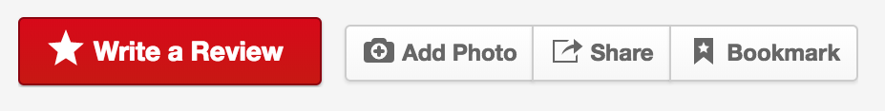
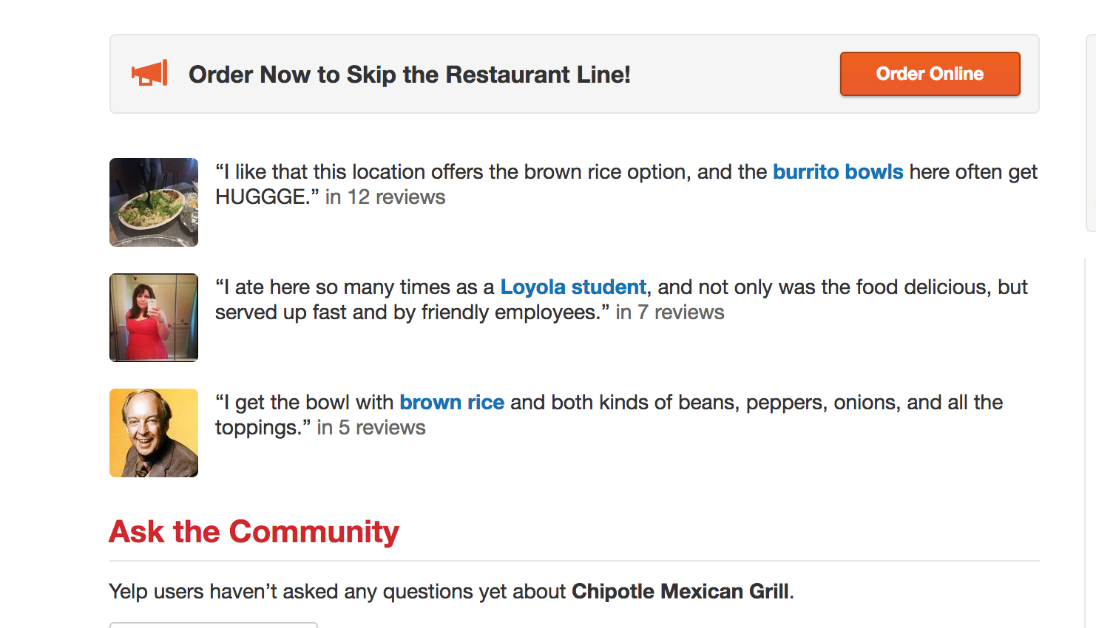
Memory
User take-away
Importance & relevance
Use of solely icons
Cognitive overload
Get rid of excess reviews shown by most popular word
Notes:
User take-away
In the end, you want user of Yelp to take away certain important factors: got what they came for
Things like at top & easily identifiable aspects draw attention & leave imprint in memory of individual
Use icons instead of words, more memorable, universal images understood by users, takes less space

